Slide 1
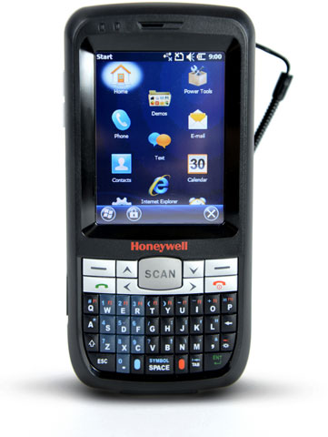
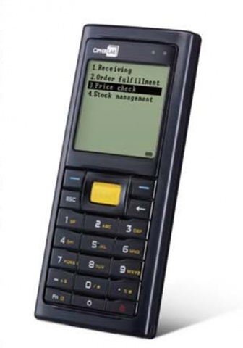
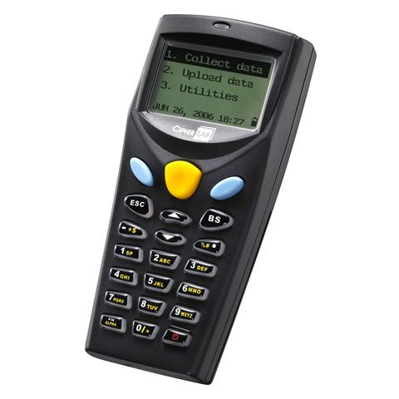

Slide 2
Pilih lokasi
Collect Data
Upload Data
Utilities
FTP
SO Location1
SO Location2
SO Location3
SO Location4
SO Location5
Lokasi Lainnya
SO Location6
SO Location7
SO Location8
SO Location9
SO Location10
Back

Slide 3
Scan article
Loc06
PLU : Manual
Desc : Otomatis
Price : Otomatis
Qty : Manual
No : Otomatis

Slide 4
Cek total scan
Collect Data
Upload Data
Utilities
FTP
Program Setting
Browse Data
Delete Data
Reader Test
Set Date/Time
Load Application
Memory & Power
Loc-1
Loc-6
Loc-7
1st lookup file
[ 309 / 309 ]
Loc01,400027150007,1

Slide 5
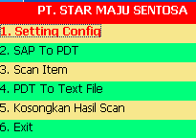
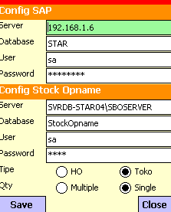
Setting Config

Slide 6
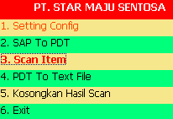
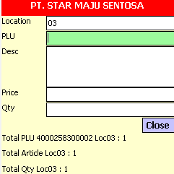
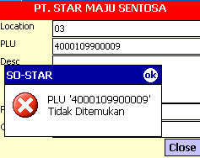
Scan article

Slide 7
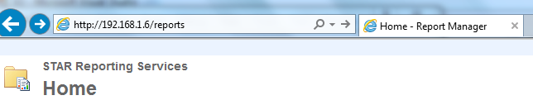



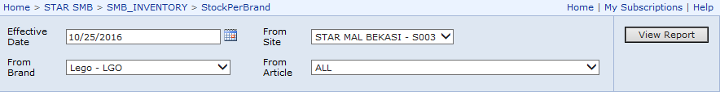
Stock by brand

